Slide 1
MFRE Summer Series: R Programming 2 Harry Izatt
2023/24 Summer Program

Slide 2
Last time:
1. Data Structures and Control Flow Review
2. Best Practices for R Programming

Slide 3
Today: Tidyverse
Data Cleaning with `dplyr`
Subsetting data
Filtering data
Mutating data
Data Visualization with `ggplot2`
Line plots
Scatter plots
Regression plots

Slide 4
R Workshops Roadmap
R Workshop 1: Yesterday
Working in basic R, general topics
1. Review data structures and manipulation
2. Best practices for R programming
R Workshop 2: Today
Dive into specific industry-standard data analysis library (Tidyverse)
3. Introduction to data cleaning: `dplyr`
4. Introduction to data visualization: `ggplot2`

Slide 5
R Workshop 2 Case (1/2)
So, you sort of get what you’re doing in R. Now it’s time to get into the data.
You start out with getting the data set up for visualizations
You make alterations with loops
You make a function here and there
You even leave comments!
You decide to get some help from your coworker, Hadley, who knows R inside and out

Slide 6

R Workshop 2 Case (2/2)
Hadley looks at your R Markdown file
When he finally stops laughing he says, “I’ve got a better way to do this.”
(Based on personal experience!)
He introduces you to the Tidyverse, a library of R packages for doing data work
Hadley knows his stuff, so you’re certain this is the best way to go.
Time to get started with the Tidyverse!

Slide 7
R Workshop 2 Itinerary
3. Introduction to Data Cleaning: `dplyr`
3.1 What is the Tidyverse?
3.2 5+1 Functions
3.3 `filter()`
3.4 `arrange()`
3.5 `select()`
3.6 Pipes
3.7 `mutate()`
3.8 `summarise()`
3.9 `group_by()`
4. Introduction to Data Visualization: `ggplot2`
4.1 Basics of `ggplot2`
4.2 Line Charts
4.3 Scatter Plots

Slide 8
Section 3
Data Cleaning and dplyr

Slide 9
The Tidyverse
What is the Tidyverse?
Library of R packages for data work
Most important:
dplyr: data cleaning and manipulation
Rough equivalent: Pandas
ggplot2: data visualization
Rough Equivalent: matplotlib
Why does this exist?
Base R meant for statistical programming, but data functionalities lacking
Tidyverse has consistent data philosophy, “Tidy Data”, making packages highly compatible

Slide 10
5+1 Functions: Core tools for data cleaning
filter()
Specify logical condition on Tibble; reduce to rows where it applies
arrange()
Specify column(s); order rows by column value (ascending, descending)
select()
Specify column names; remove all others
mutate()
Create new columns through manipulations of others, e.g. addition, division, etc.
summarise()
Get summary statistics
group_by() (the +1)
Establish “groups” to partition dataset by, pair with summarise() for specific summary stats

Slide 11
Heading to RStudio!

Slide 12
Section 4
Data Visualization and ggplot2

Slide 13
The Tidyverse (cont)
Packages vary by topic, but all compatible
Once data set up using dplyr, visualize with ggplot2
ggplot2 = “Grammar of graphics plot”
Specific method of plot assembly
Call pieces in one-by-one, set up complicated plot from simple components

Slide 14
The Tidyverse (cont)
Pieces of a ggplot2 visualization
`ggplot()` function call (initializes plot in code chunk)
Geoms
geom_line(), geom_scatter(): the geometric objects displaying data in plot
Some show exact data points, others fit statistical model to data
Aesthetic mappings
aes()
Used to integrate data’s other dimensions into plot: sizes, shapes, colors
E.G. “levels” of categorical variable
Example
Use geom_scatter() to show overall inflation (x-axis) versus food inflation (y axis)
Aesthetic mapping to display points with different shape by what decade
Square for 2000-2009, circle for 2010-2019, etc

Slide 15
Heading to RStudio!

Slide 16
Conclusion

Slide 17
What we learned
How to filter rows, select columns
Ordering and slicing tibbles
Mutating variables
Coding with Pipes
Summary statistics and grouping
Building ggplot2 visualizations with geometric objects and aesthetics

Slide 18
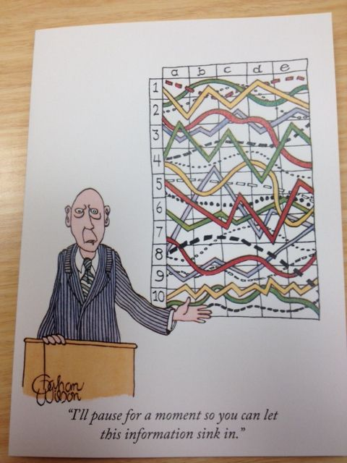
Down the road:
Python, R Application Workshops
Same case study, done in each language!
Compare and contrast approaches

Slide 19
Thanks for coming!
2023/24 Summer Program

